Slide 2
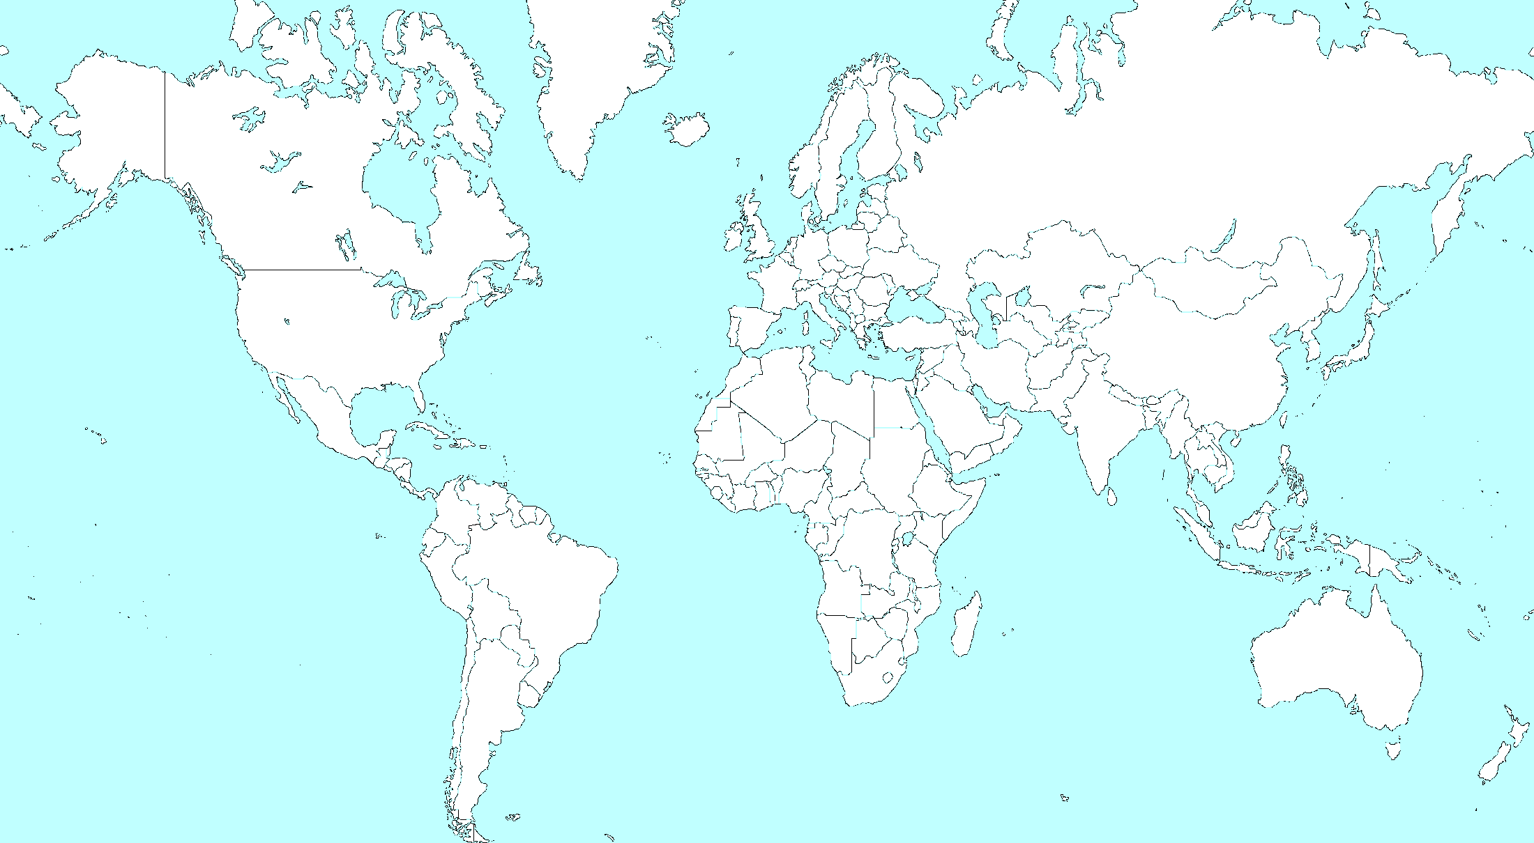
World History Review
The Modern World 1945-2000

Slide 3
Directions: There are five questions in this review. After reading each question, decide what region of the world you think it concerns. Then click your mouse button to see the bullseye label that region. You will then have seven minutes to use your memory, notes and textbook to answer the questions in essay format. Selected students will share their essays.

Slide 4
1 Identify the three countries of this region, the religious and ethnic divisions which separate them, the story of their gaining independence from a colonial power, and some of the key people in this story.

Slide 5
2 How and why did this part of the world come to be divided after WWII? Identify major countries and people in the story. Explain why and how political change came to this region.

Slide 6
3 Explain how this large nation changed its political system and was separated into numerous new nations. Identify key people and ideas.

Slide 7
4 How has this country increased its economic might after years of poverty and political turmoil? Identify key people and events.

Slide 8
5 Identify and describe the three religious faiths that consider this region sacred. Describe the creation of a new nation in this region after WWII, events that led to that creation, and the wars and attempts at peace that have followed.

Slide 9
the end

