Slide 1
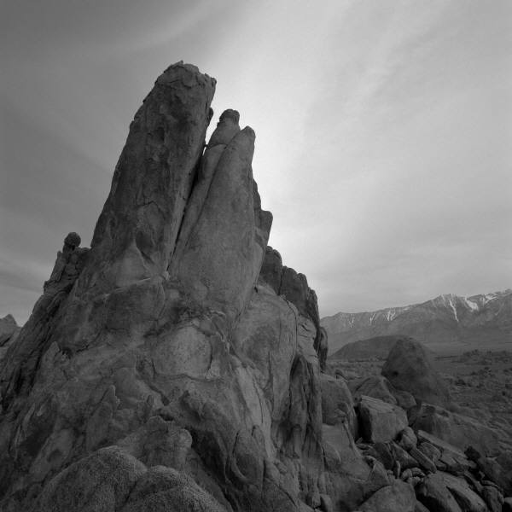
Images of the industrial revolution

Slide 2
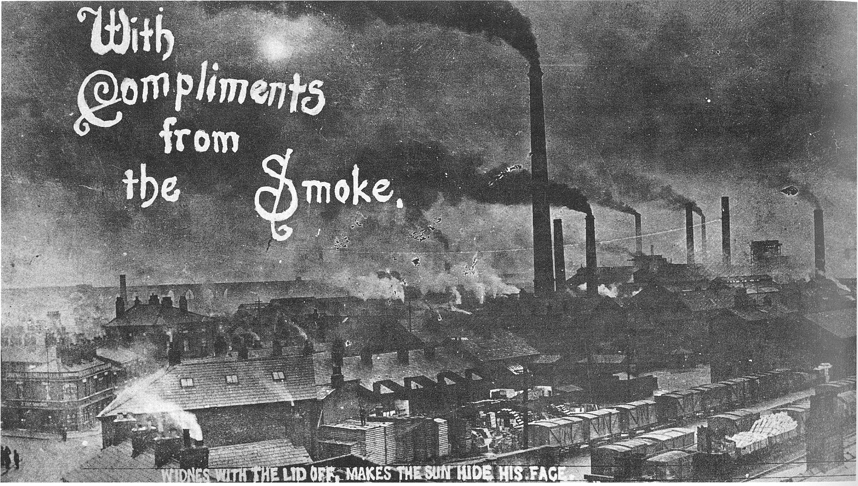
Growth of Industrial Cities

Slide 3
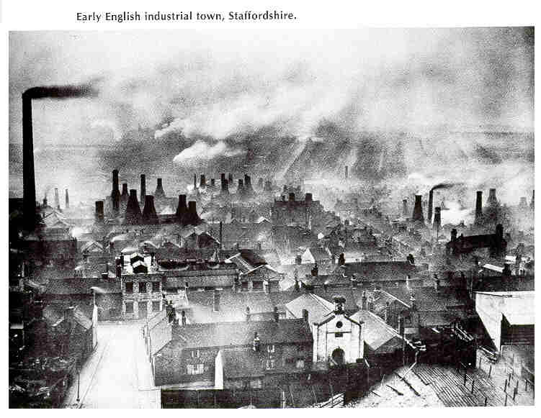
Growth of Industrial Cities

Slide 4
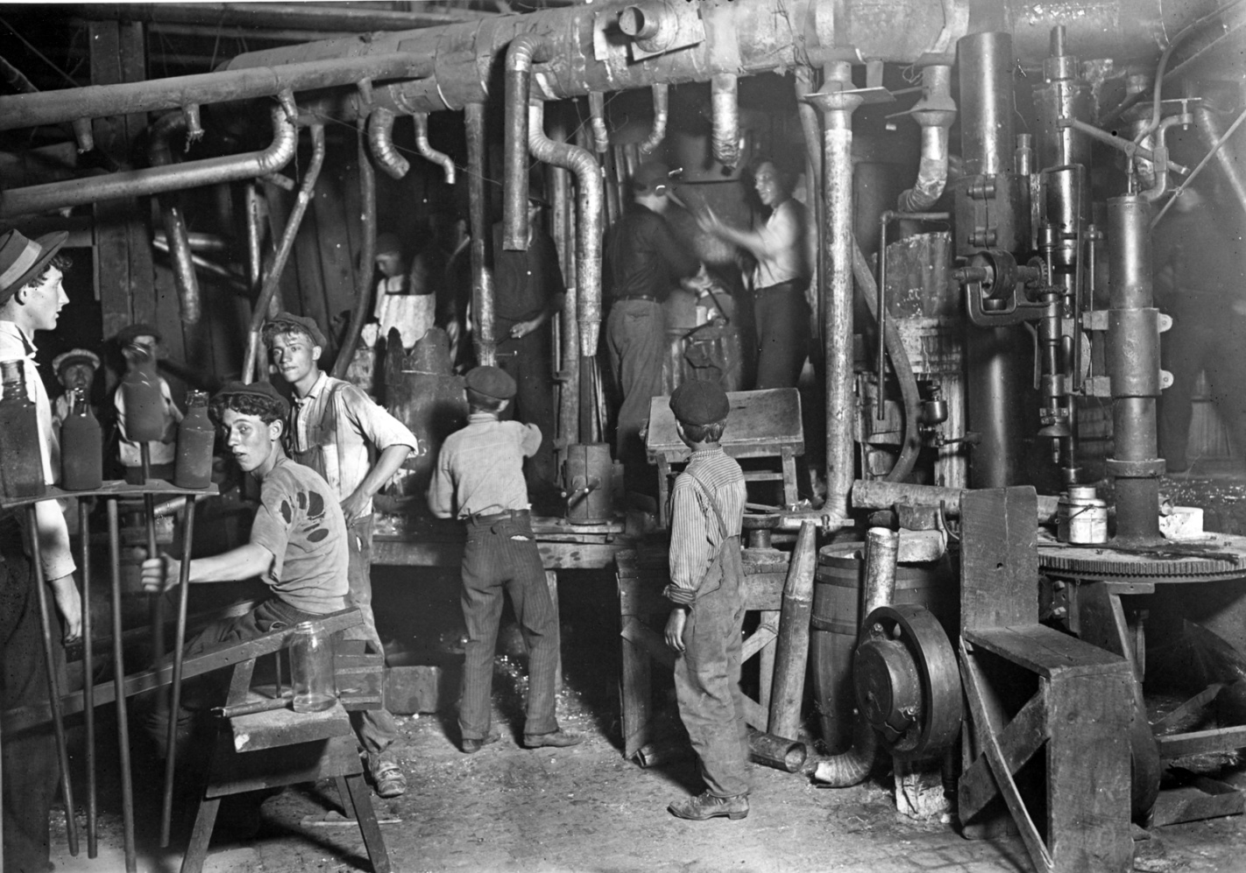
Child Labor

Slide 5
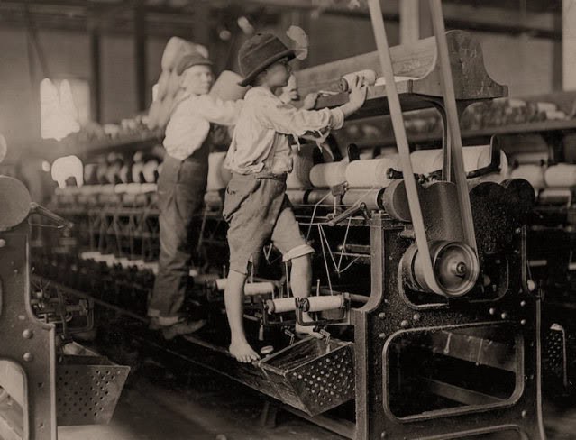
Child Labor

Slide 6
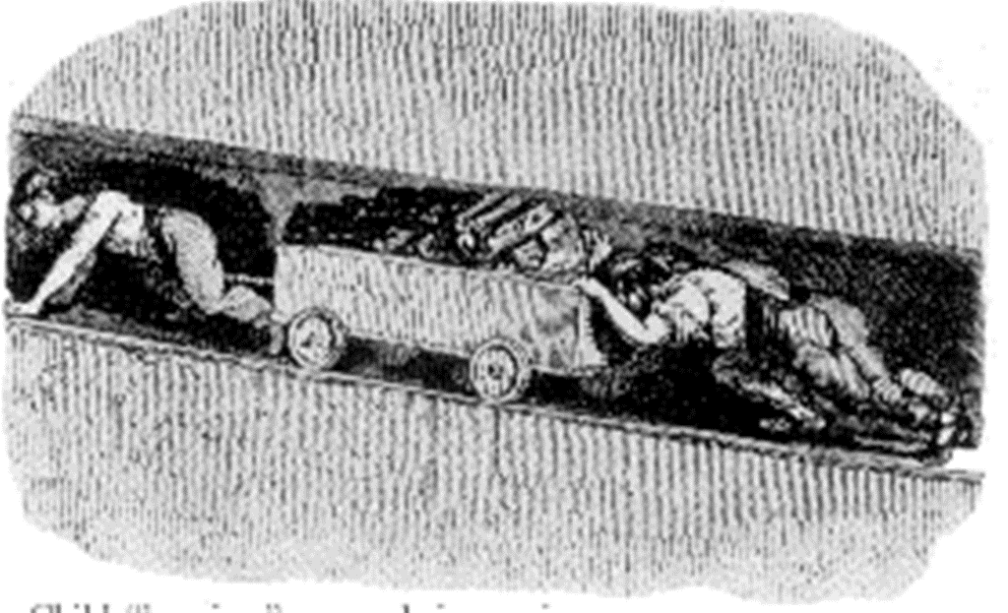
Coal Mines – children were often employed because of their small size

Slide 7
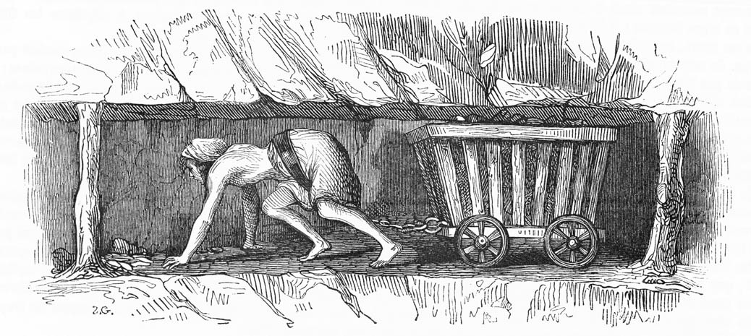
Coal Mines

Slide 8
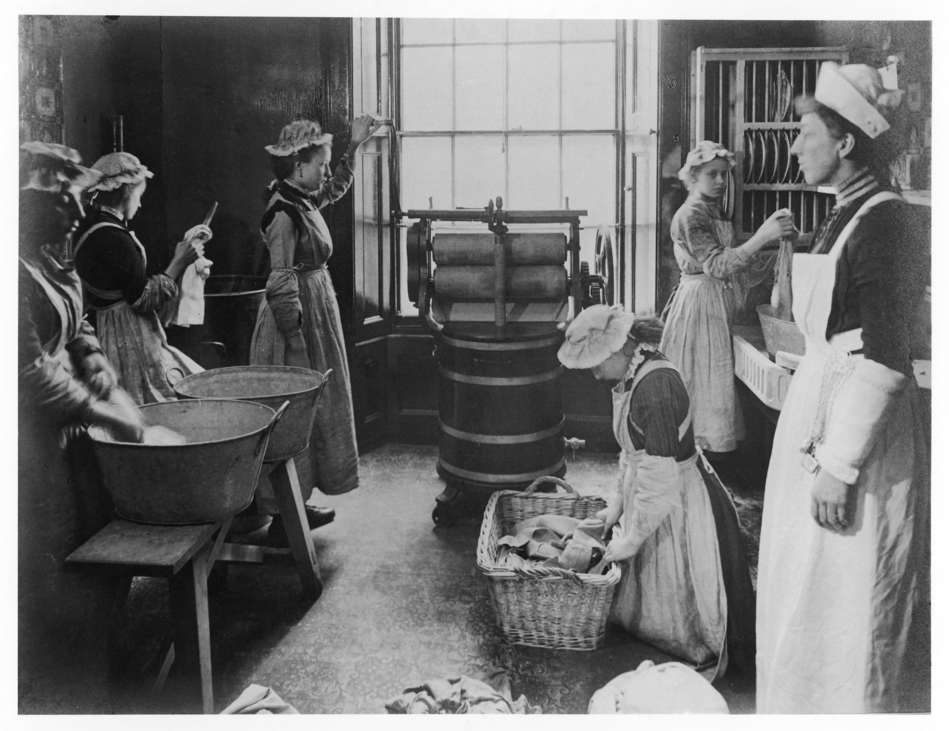
Woman training to be domestic servants

Slide 9
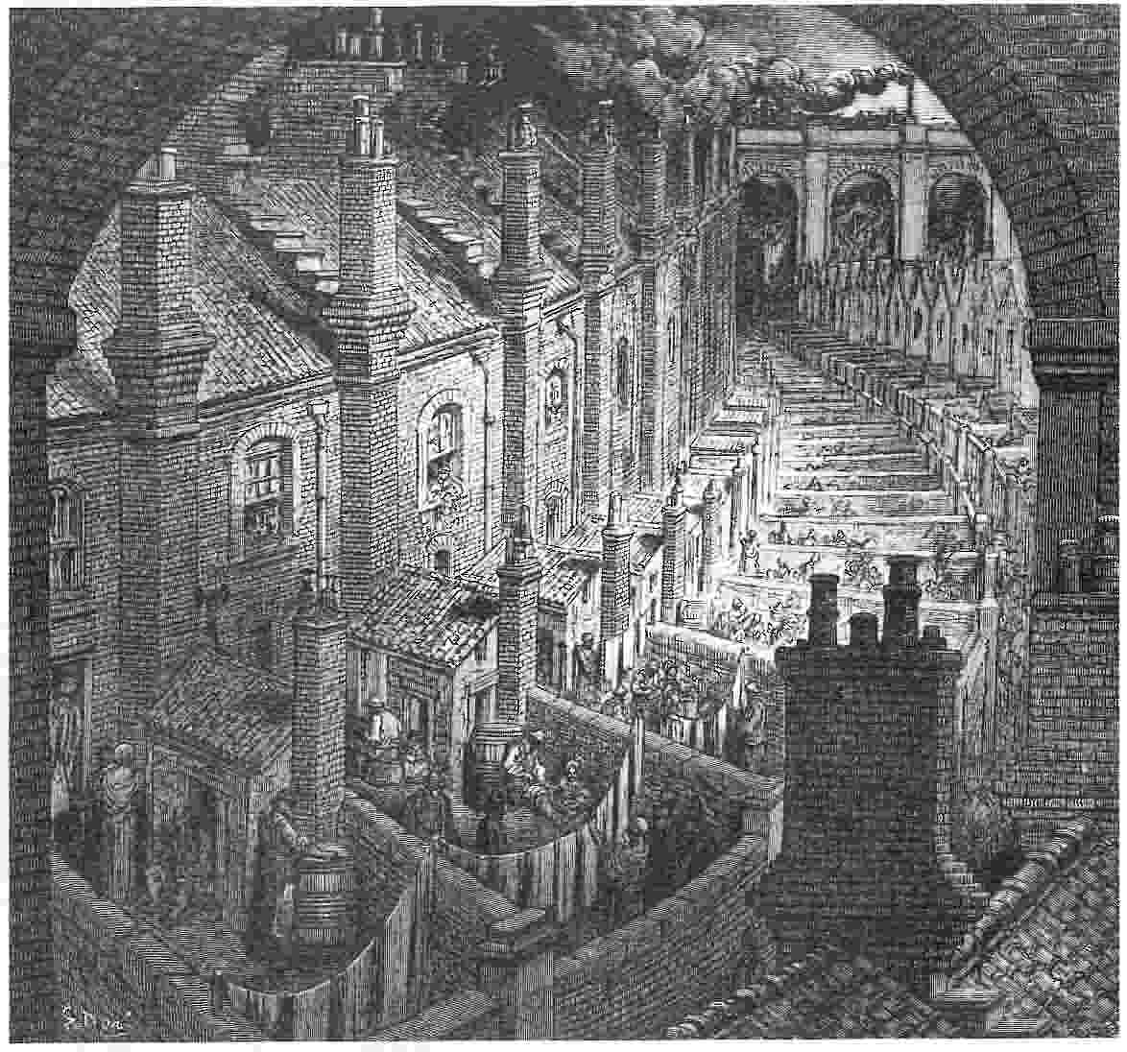
London tenement housing

Slide 10
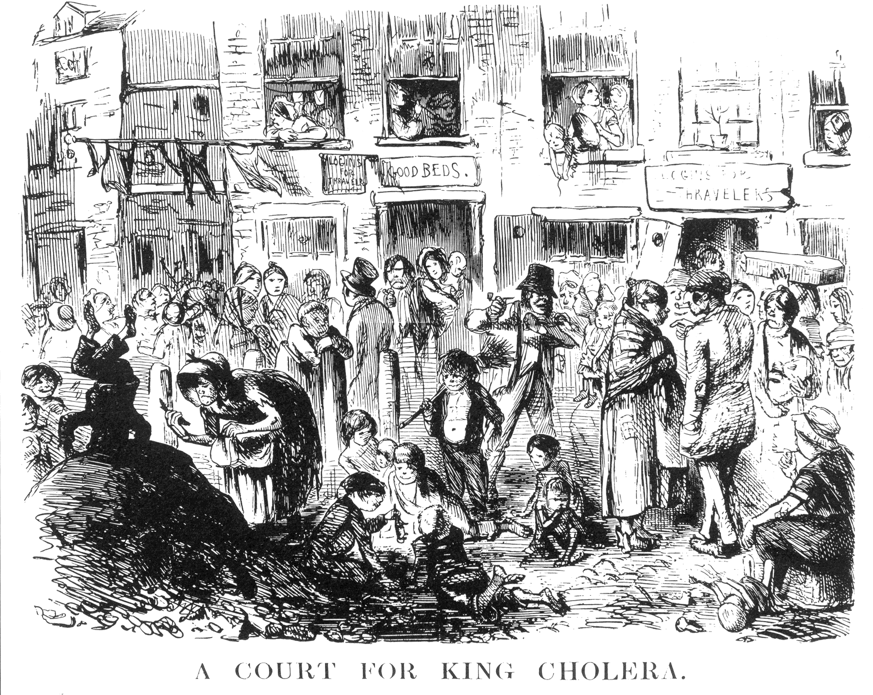
Cholera often broke out in the crowded cities, spread by water contaminated with human feces

Slide 11
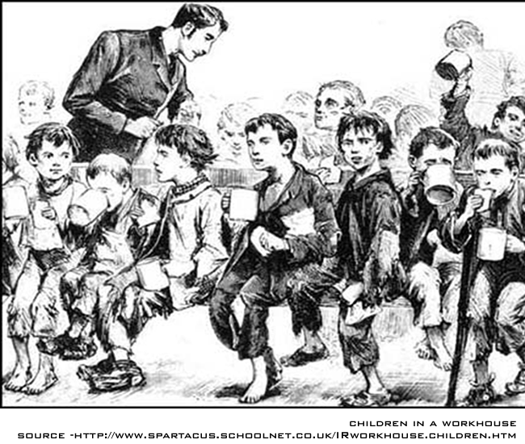
Children in an English workhouse

Slide 12
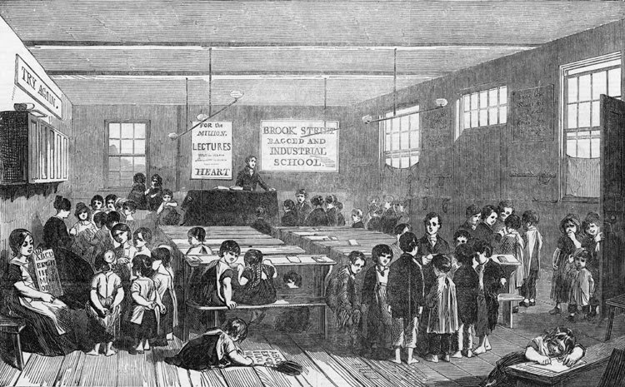
Factory school

Slide 13
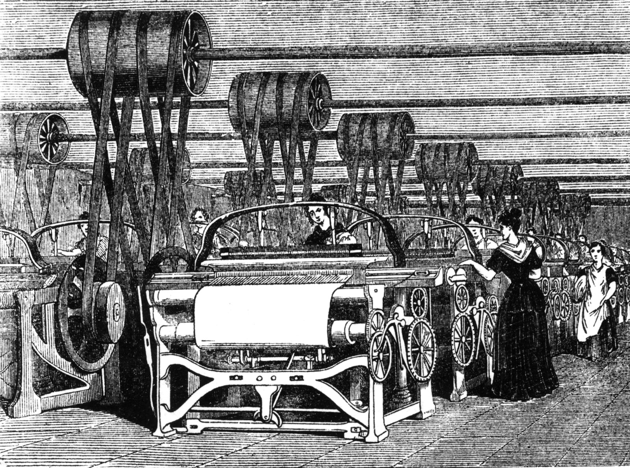
Factory women

