Slide 1
NATIONALISM
Nationalists: people who believe that people of a single “nationality” should unite under a single government
Goal of Nationalists? Create a NATION-STATE
Bonds that create a nation-state? Nationality, Language, Culture, Religion, History, and Territory

Slide 2
NATIONALISM
Identify three empires that were breaking up in the 19th century.
Identify groups of people within those empires that wanted their own nation-states.

Slide 3
Italian Unification
Accomplished by 1870 with the French leaving Rome
Significant Figures:
Mazzini
Cavour
Garibaldi
Victor Emmanuel II
How is unification of Italy accomplished?

Slide 4
German Nationalism
The Rise of Prussia
24-3

Slide 5
MAIN IDEA
In the late 1800s, Otto von Bismarck transformed Germany from a loose confederation of separate states into a powerful empire.
THINK ABOUT:
How Italian unification differs from German unification
How is Germany unified? What tactics does Bismarck use?

Slide 8
German Confederation
Formed in 1815 at the Congress of Vienna, replacing the Holy Roman Empire
Loose confederation/political association of 39 states
Two largest states dominating the confederation
Prussia
Austro-Hungarian Empire / Austrian Empire

Slide 9
Austria / Prussia Rivalry
Austrian Empire
Prussia
Multinational Empire
Major power in Europe
Dealing with issues in Italy (Venetia & Lombardy)
Wars with France, Italy, and Prussia
Primarily German population
Powerful army
Authoritarian government – strong king
Industrialized quickly

Slide 10
German Revolution of 1848
Liberal rioters in Berlin
Result in the Frankfurt Parliament
Desire for a unified Germany grows
Austria opposes centralized government in Germany
Prussian king offered crown of a unified German Empire
Democratic reforms do not extend to Prussia, however

Slide 11
Basis for German nationalism?
German language
1834: Zollverein created
Customs union that removed tariffs on products traded between German states (economic unity)
By 1854, majority of German involved
Cultural unity

Slide 12
If there is going to be one Germany, which major power should lead the fight for unification?
Prussia
If Prussia is the leading force in German unification, what is its Italian counterpart?
Piedmont-Sardinia

Slide 13
Setting the Stage for German Unification
Revolution of 1848
Liberal revolution
Desire for German unification grows
Promise of Reforms in Prussia
Promise of liberal reforms
Creation of the Zollverein
Economic alliance between German states

Slide 14
Prussian Government
King Wilhelm I
Prime Minister Otto von Bismarck

Slide 15
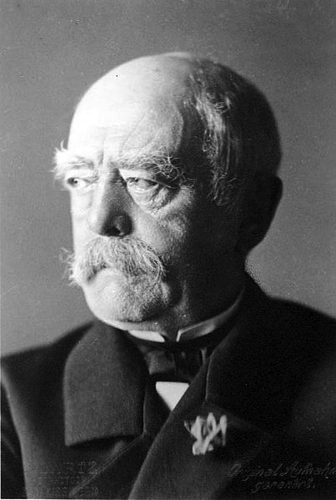
Otto von Bismarck (1815-1898)
Prime minister of Prussia 1862-1890
Became chancellor of Northern German Confederation in 1867
“The Iron Chancellor”
“ The less people know about how laws and sausages are made, the better they’ll sleep at night”

Slide 16
Bismarck’s Philosophy
Not liberal like revolutionaries; conservative, supported king of Prussia
Believed Prussia destined to lead German people to unification
Practiced realpolitik
“Politics of reality”
Tough power politics, no room for idealism
Using “blood and iron” to gain German unification
Builds up Prussian army

Slide 17
Steps to German Unification
Bismarck becomes Prime Minister and begins administering a policy based on realpolitik
Danish War (1864)
Austro-Prussian War (1866)
Creation of Northern German Confederation (1867)
Ems Dispatch, catalyst for war (1870)
Franco-Prussian War (1870-1871)
Treaty of Frankfurt
Coronation of Kaiser Wilhelm I

Slide 18
First actions as Prime Minister
King Wilhelm I unable to pass reforms expanding military through a liberal parliament
Junkers (Prussia’s landowning class) support the king
Strongly conservative and opposed liberal class
Bismarck declares that he will rule without consent of Parliament – violating constitution

Slide 19
“Germany does not look to Prussia’s liberalism but to her power…Not by speeches and majorities will the great questions of the day be decided – that was the mistake of 1848-1849 – but by iron and blood”
~Otto von Bismarck

Slide 20
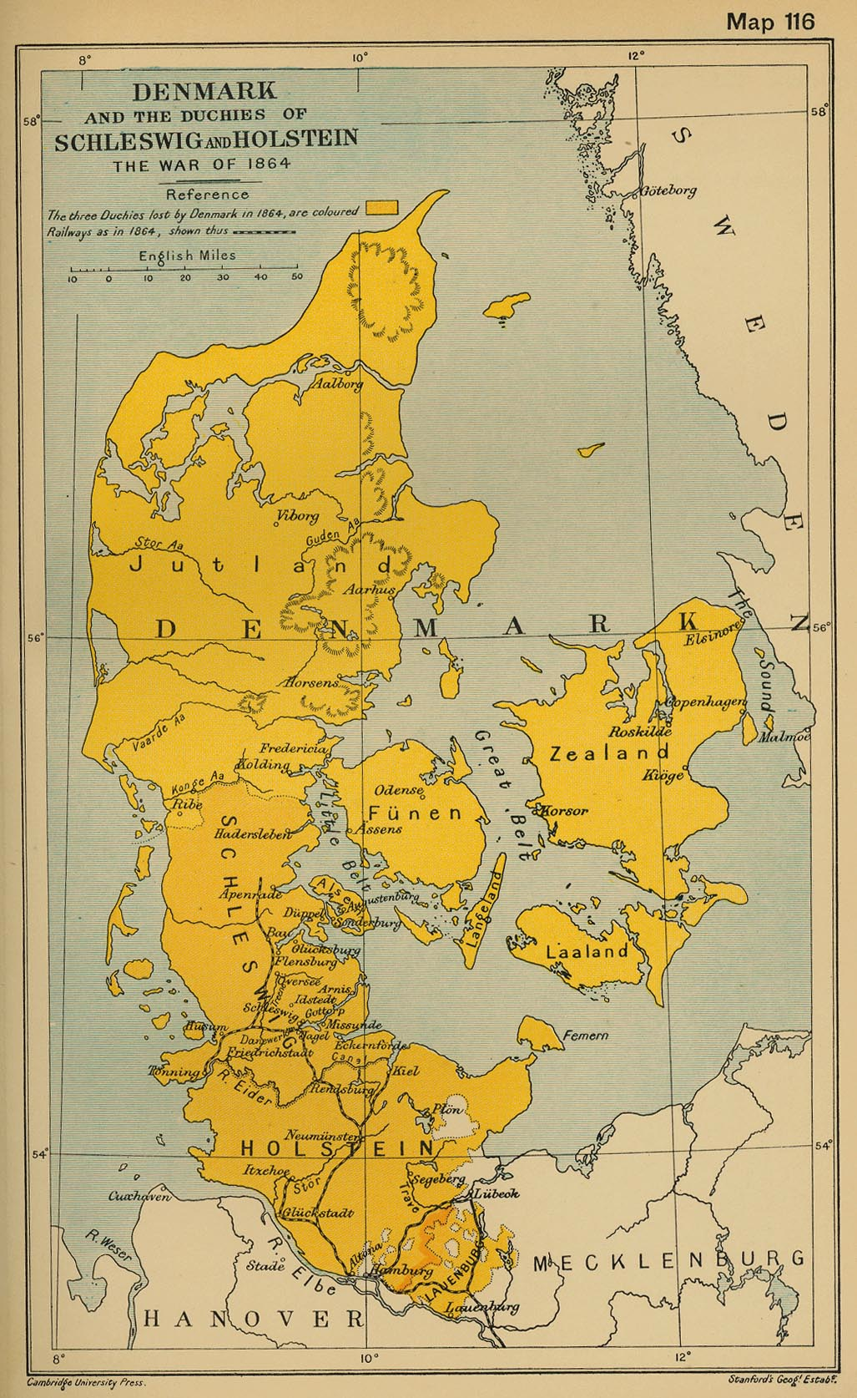
Danish War (1864)
Holstein population is German, Schleswig mixture of Germans and Danes
Denmark constitution in 1863 annexes Schleswig for Denmark
Prussia and Austria protest new constitution, demand it be revoked
War starts:
Prussia and Austria vs. Denmark
Notes:
Population of Holstein = German; Schleswig = mixture of Germans and Danes
Dnaish king ruled the two duchies even though their constitutions made them seaparte from Denmark
1863: Christian IX took the Danish throne, proclaimed a new constitution in which he tried to annex Schleswig for Denmark
Prussia and Austria protest new constitution; demand it be revoked; Denmark refuses → War
Denmark hopes for help from France or Great Britain, doesn’t happen. Three months of fighting

Slide 21
Results of Danish War
Brief fight – Three months
Denmark gives up Schleswig & Holstein
Disagreements over how to split up land
Ultimately, Prussia gets Schleswig and Austria gets Holstein
Increases national pride amongst Prussians
Support for Prussia as head of new Germany increases
Sets the stage for conflict between Prussia and Austria
Notes:
Three months of fighting; Denmark surrenders;
Peace treaty – two duchies to Prussia and Austria jointly
Austria wants combined to create one new state for German Confederation
Prussia opposes idea
Prussial gets Schleswig and Austria gets Holstein

Slide 22
Bismarck’s Backroom Dealings
Bismarck prepares for conflict with Austria
Persuades Napoleon III to remain neutral
Forms alliance with Italy (Cavour in Piedmont)
Provokes Austria into declaring war on Prussia in 1866; war centered on territorial issues with Schleswig and Holstein

Slide 23
Austro-Prussian War, 1866
Also known as Seven Weeks War
Prussian advantages
Railroads (better transportation system)
Telegraphs (better communication)
Modern weaponry (better army)

Slide 24
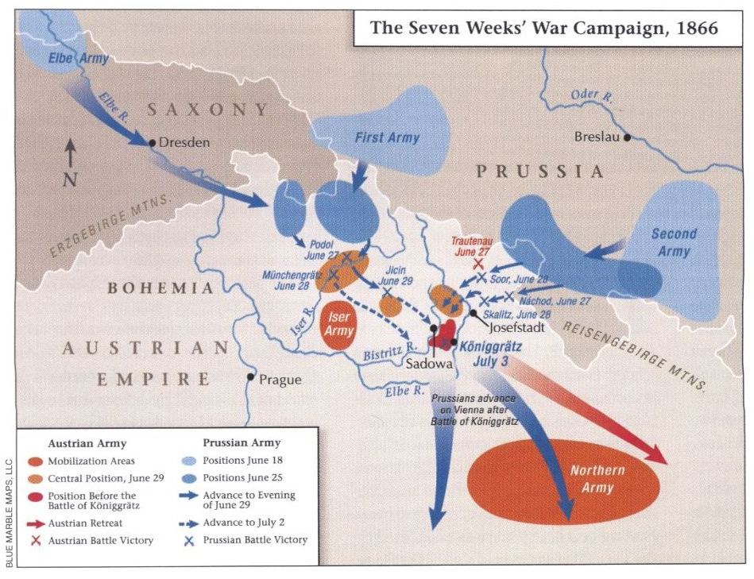

Slide 25
Results of the Austro-Prussian War
Prussians win!
Balance of European power shifts dramatically
Treaty of Prague (peace treaty at end of war)
German Confederation dissolved
Austria surrenders Holstein
Italy gains Venetia

Slide 26
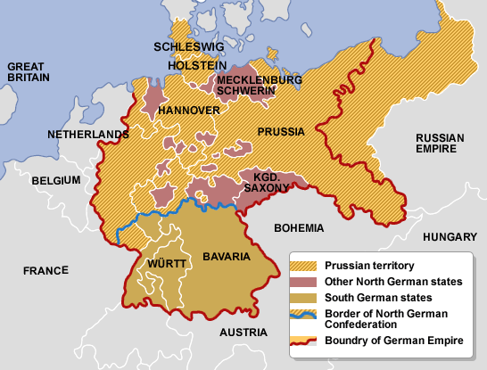
Creation of Northern German Confederation (1867)
After Austro-Prussian War
Northern German states unite with Prussia to form North German Confederation
Each state has self-government
King of Prussia is president of Confederation
Eliminates the German Confederation, led in part by Austria

Slide 27
Kaiser Wilhelm I and Vincent Benedetti at Ems

Slide 28
EMS Telegram
King William responds to telegram from French
Bismarck alters William’s response to make it sound like an insult
Telegram is published → angers the French!
France declares war on Prussia in June 1870
Notes:
1868 revolt in Spain, new king Prince Leopold von Hohenz
France protests
Hohenz’s name withdraws
French demand that King William forever renounce any attempt to put a Hohenzollern on the throne of Spain
Demand presented to King
King William refuses to promise, responds in a telegram in a friendly manner
Bismarck doctors the report to make it sound like the king refused to see the ambassador again
French use this telegram as cause for war

Slide 29
Franco-Prussian War (1870-1871)
All German states joined in war against France
No outside nation came to help France
Short, but decisive war – German victory
Results of war:
French Empire collapses
France loses Alsace-Lorraine
France pays Germany 5,000,000,000 francs
German army occupies much of France

Slide 30
French Soldiers

Slide 31
St. Cloud, Paris

Slide 32
Siege of Paris, Soup Kitchen

Slide 33
St. Cloud, Paris

Slide 34
Napoleon III and Bismarck

Slide 35
Proclamation of the German Empire

Slide 36
German Empire
William I proclaimed Emperor of Germans at Versailles on January 18, 1871
Berlin becomes empire’s capital
Constitution that unites 25 German states in federal form of government
Local government in each state
Emperor (or kaiser) headed government with a lot of power

Slide 38
Balance of Power Shifts
1815 – balance of power established with Five Great Powers
Changes by 1871
Britain and Germany were most powerful
Austria, Russia, and Italy were far behind; France in the middle
Creation of two new states – Italy and Germany

