Slide 1
Chapters 3 & 4 Review
world history

Slide 2
Explorers
Events & People
Places
Economics
Odds & Ends
10
10
10
10
10
20
20
20
20
20
30
30
30
30
30
40
40
40
40
40
50
50
50
50
50

Slide 3
Category 1 questions follow

Slide 4
Category 1
His school of navigation enabled the Portuguese to explore the western coast of Africa.
10

Slide 5
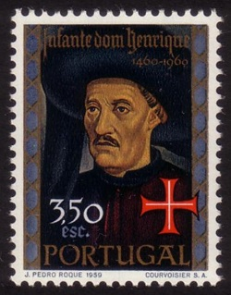
Category 1
Prince Henry the Navigator
10

Slide 6
Category 1
The first European explorer to sail around Africa
and reach India, in 1498.
20

Slide 7
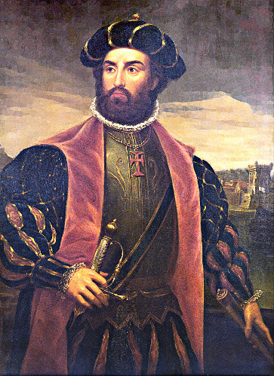
Category 1
Vasco da Gama
20

Slide 8
Category 1
This Spanish conquistador defeated the Inca Empire.
30

Slide 9
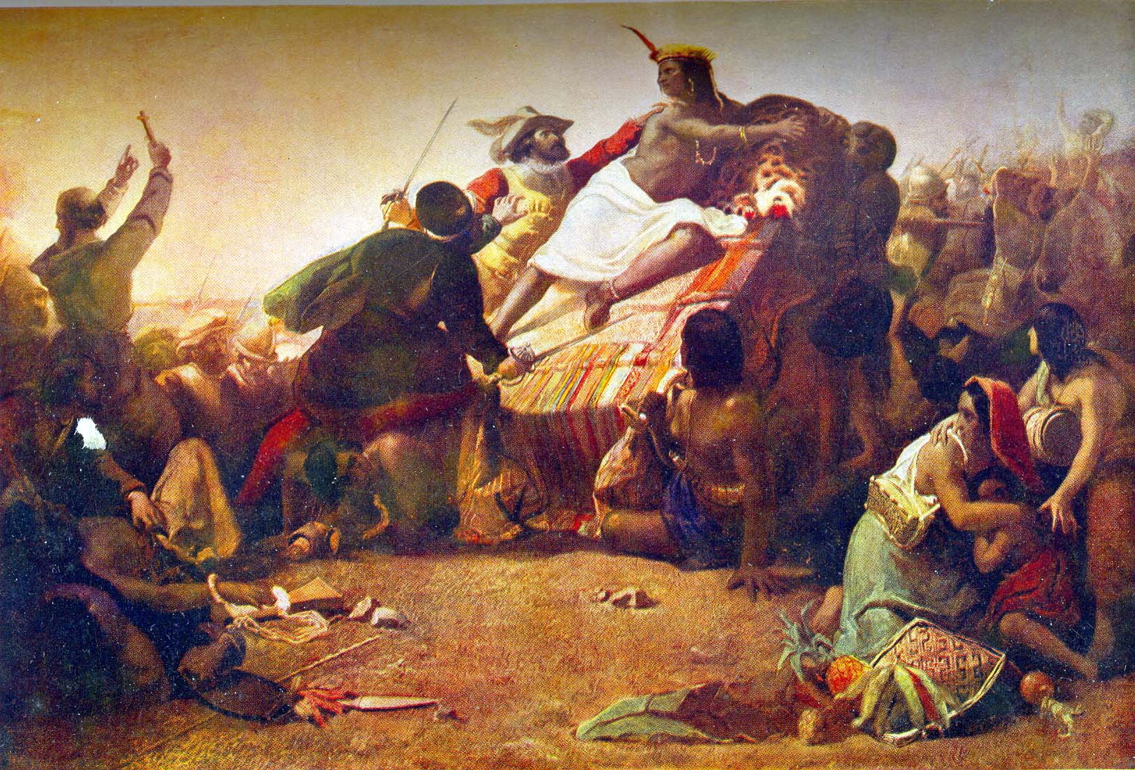
Category 1
Francisco Pizarro
30

Slide 10
Category 1
This Italian discovered New York Harbor.
40

Slide 11
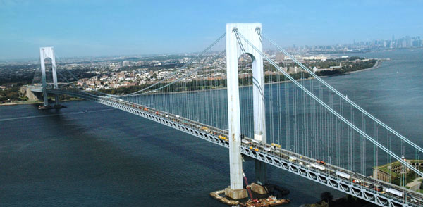
Category 1
Giovanni da Verrazzano
40

Slide 12
Category 1
His expedition was the first to
circumnavigate the earth.
50

Slide 13
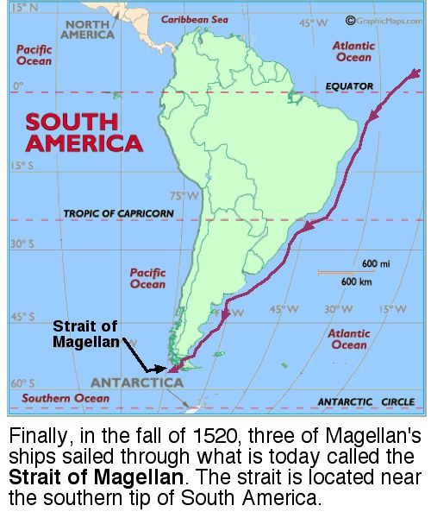
Category 1
Magellan
50

Slide 14
Category 2 questions follow

Slide 15
Category 2
This treaty divided the world between
Spain and Portugal.
10

Slide 16
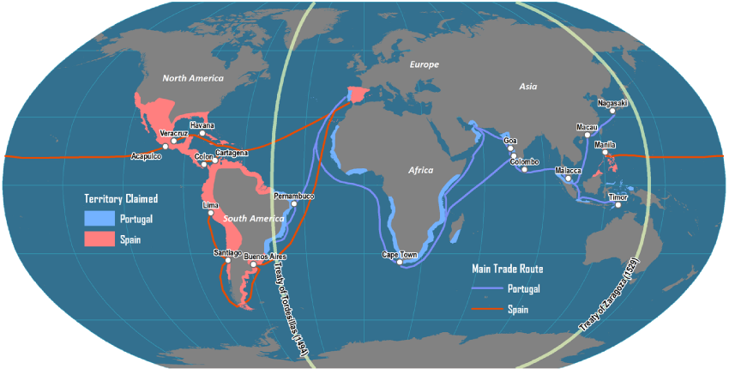
Category 2
The Treaty of Tordesillas
10

Slide 17
Sieur da La Salle claimed the Mississippi river valley for his French king, _________.
He named it ______________.
20

Slide 18
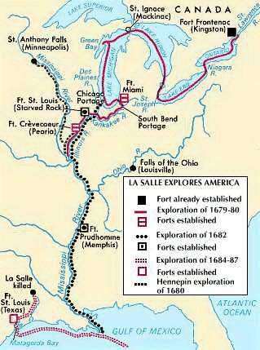
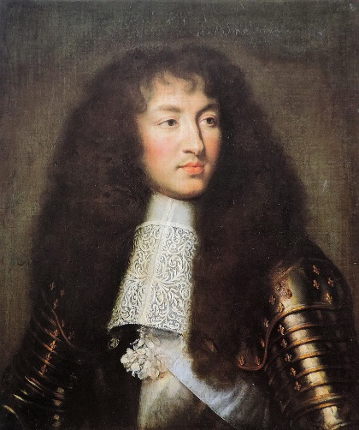
Category 2
Louis XIV - Louisiana
20

Slide 19
Category 2
He claimed the Dutch colony of New Netherland for England and renamed it for himself.
30

Slide 20
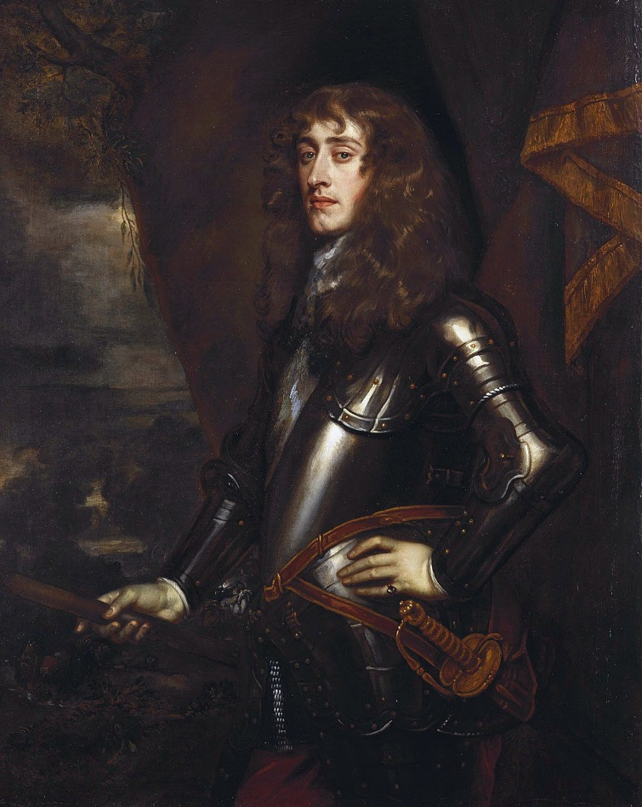
Category 2
The Duke of York
30

Slide 21
Category 2
This Native American ruler led an attack on villages in Massachusetts, leading to a conflict known as King Philip’s War.
40

Slide 22
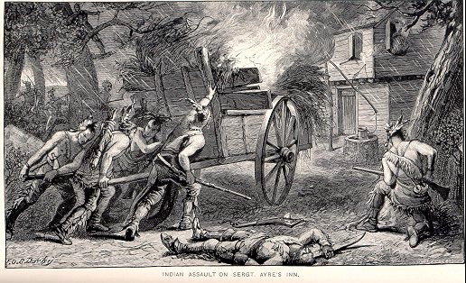
Category 2
Metacom
40

Slide 23
Category 2
Enslaved when 11, he later wrote about conditions on slave ships (and worked to end the slave trade in England).
50

Slide 24
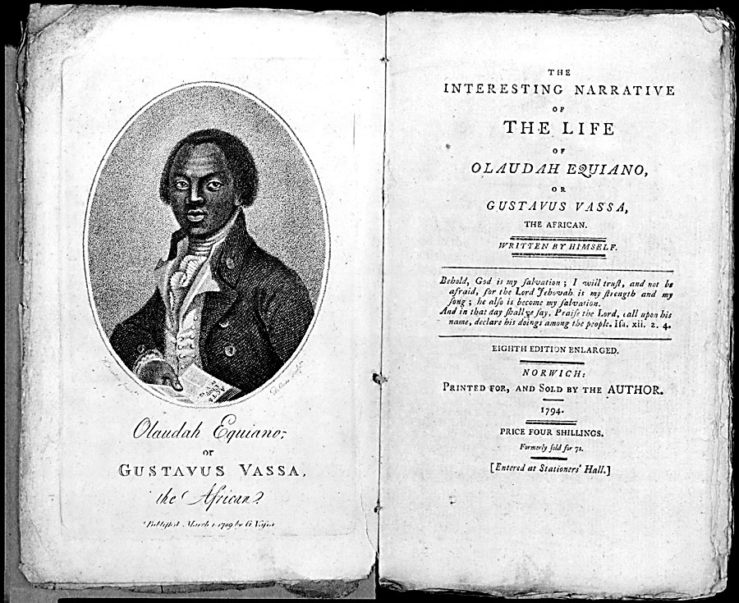
Category 2
Olaudah Equiano
50

Slide 25
Category 3 questions follow

Slide 26
Category 3
The first permanent English settlement in America.
10

Slide 27
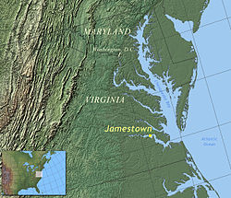
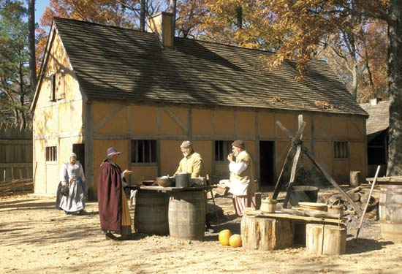
Category 3
Jamestown (1607)
10

Slide 28
Category 3
The second English colony, in Massachusetts.
20

Slide 29
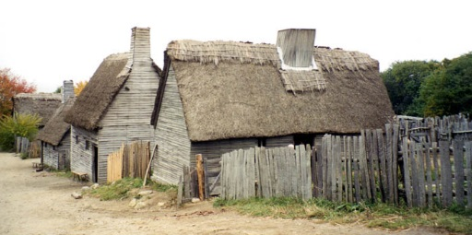
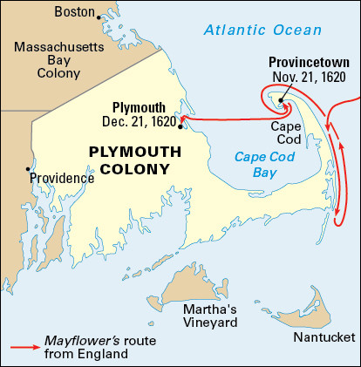
Category 3
Plymouth
20

Slide 30
Category 3
This Dutch colony welcomed people of many countries and religious faiths, and became wealthy from trade.
30

Slide 31
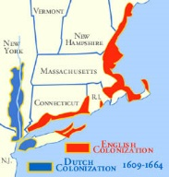
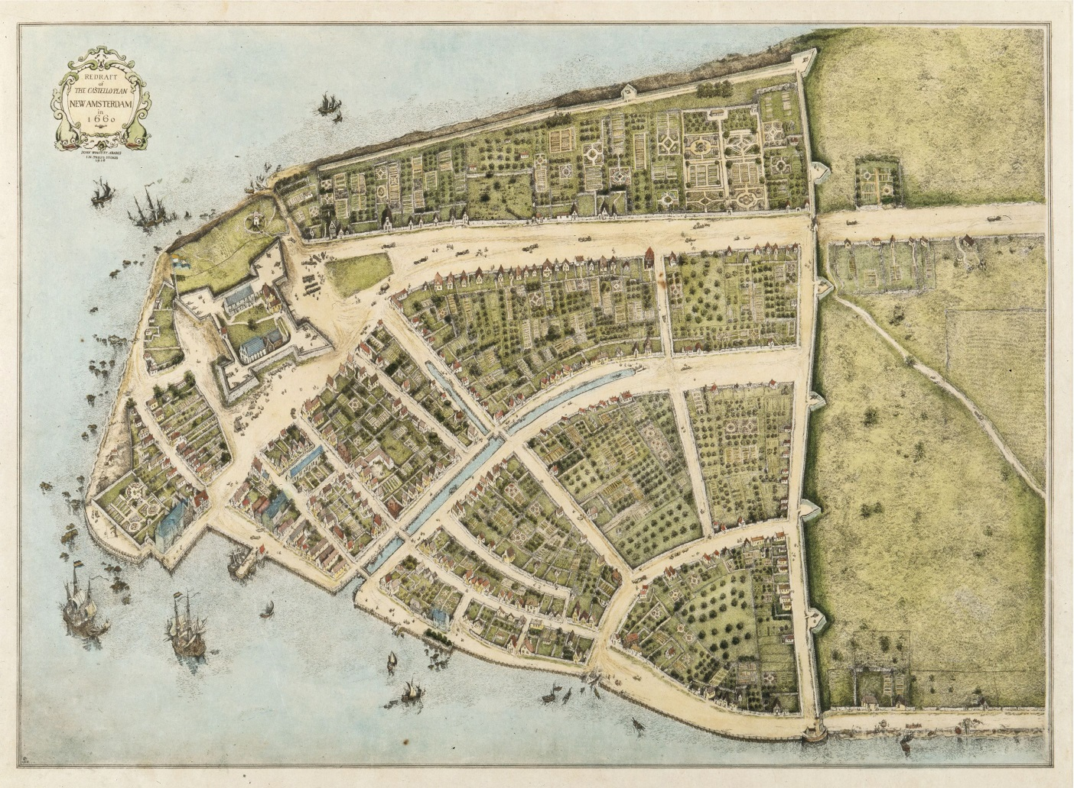
Category 3
New Netherland
30

Slide 32
Category 3
Cortés created a Spanish colony in Mexico after defeating the Aztec emperor ______________.
40

Slide 33
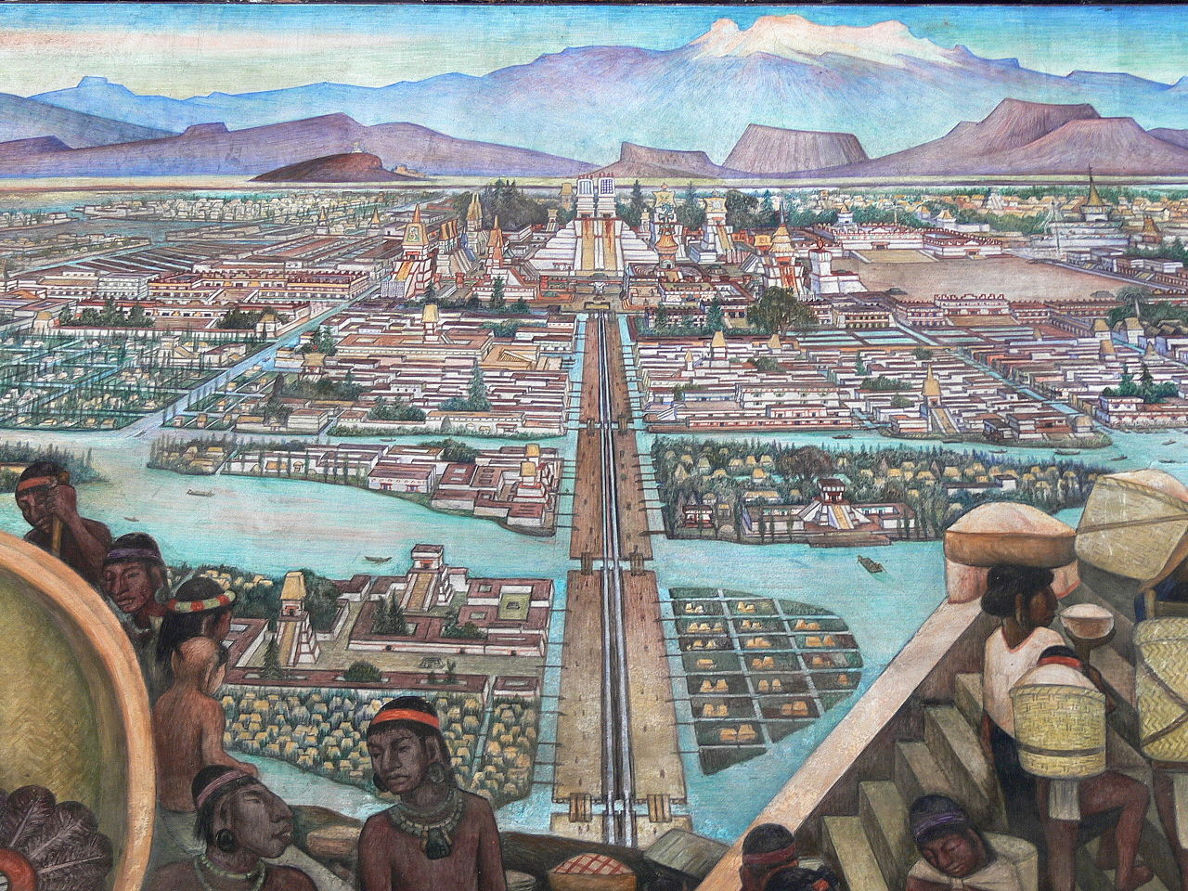
Category 3
Montezuma II
40

Slide 34
Category 3
The Dutch established a colony on this East Indies island, trading for coffee, which gets its nickname from here.
50

Slide 35
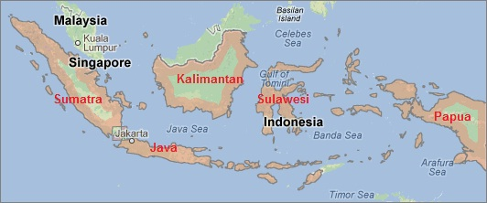
Category 3
Java
50

Slide 36
Category 4 questions follow

Slide 37
Category 4
An economic system based on investing wealth
to create profit.
10

Slide 38
Category 4
capitalism
10

Slide 39
Category 4
A 17th century type of company in which a number of people pooled their wealth to establish colonies and trade.
20

Slide 40
Category 4
joint-stock company
20

Slide 41
Category 4
An economic policy which equated a
country’s power with its wealth.
30

Slide 42
Category 4
mercantilism
30

Slide 43
Category 4
The condition when a country exports
more than it imports.
40

Slide 44
Category 4
favorable balance of trade
40

Slide 45
Category 4
The global transfer of food, plants and animals between the old world and the new.
50

Slide 46
Category 4
The Columbian Exchange
50

Slide 47
Category 5 questions follow

Slide 48
Category 5
The mixed Spanish and Native American population of much of Mexico and other Latin American countries and the United States.
10

Slide 49
Category 5
mestizo
10

Slide 50
Category 5
Columbus wanted to find wealth on his voyages to retake ___________________ from the Muslims.
20

Slide 51
Category 5
the Holy Land (Jerusalem)
20

Slide 52
Category 5
In the 15th century, Europeans used new sailing technologies to sail farther: the caravel,
the astrolabe, and _____________ sails.
30

Slide 53
Category 5
triangular
30

Slide 54
Category 5
The French and Indian War was part of a larger conflict known as __________________.
40

Slide 55
Category 5
The Seven Years’ War
40

Slide 56
Category 5
The voyage that brought captured Africans to the West Indies was known as the _______________.
50

Slide 57
Category 5
middle passage
50

